Slide 1
15-213 Recitation: Attack Lab
Jenna MacCarley
Recitation 5: 28 Sep 2015

Slide 2

Reminder
Bomb lab is due tomorrow!
Attack lab is released tomorrow!!

Slide 3
Agenda
Stack review
Attack lab overview
Phases 1-3: Buffer overflow attacks
Phases 4-5: ROP attacks

Slide 4
x86-64: Register Conventions
Arguments passed in registers:
%rdi, %rsi, %rdx, %rcx, %r8, %r9
Return value: %rax
Callee-saved: %rbx, %r12, %r13, %r14, %rbp, %rsp
Caller-saved: %rdi, %rsi, %rdx, %rcx, %r8, %r9, %rax, %r10, %r11
Stack pointer: %rsp
Instruction pointer: %rip

Slide 5
x86-64: The Stack
Grows downward towards lower memory addresses
%rsp points to top of stack
push %reg: subtract 8 from %rsp, put
val in %reg at (%rsp)
pop %reg: put val at (%rsp) in %reg,
add 8 to %rsp
Bottom
0x7fffffffffff
%rsp
Top

Slide 6
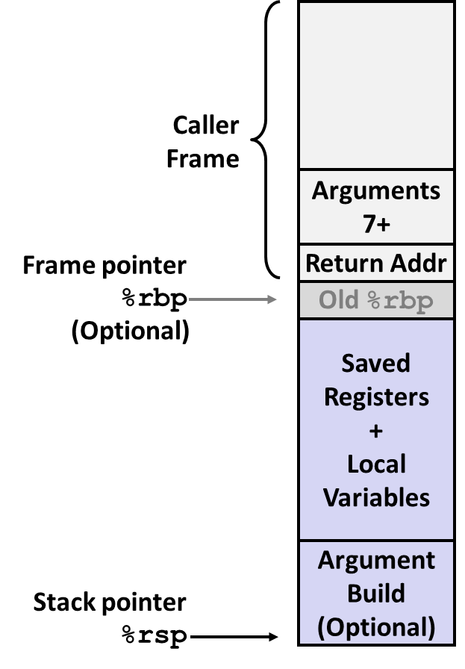
x86-64: Stack Frames
Every function call has its own stack frame.
Think of a frame as a workspace for each call.
Local variables
Callee & Caller-saved registers
Optional arguments for a function call

Slide 7
x86-64: Function Call Setup
Caller:
Allocates stack frame large enough for saved registers, optional arguments
Save any caller-saved registers in frame
Save any optional arguments (in reverse order) in frame
call foo: push %rip to stack, jump to label foo
Callee:
Push any callee-saved registers, decrease %rsp to make room for new frame

Slide 8
x86-64: Function Call Return
Callee:
Increase %rsp, pop any callee-saved registers (in reverse order), execute ret: pop %rip

Slide 9
Attack Lab Overview: Phases 1-3
Overview
Exploit x86-64 by overwriting the stack
Overflow a buffer, overwrite return address
Execute injected code
Key Advice
Brush up on your x86-64 conventions!
Use objdump –d to determine relevant offsets
Use GDB to determine stack addresses

Slide 10
Buffer Overflows
Exploit strcpy vulnerability to overwrite important info on stack
When this function returns, where will it begin executing?
Recall
ret:pop %rip
What if we want to inject new code to execute?
0xAABBCCDD
0xFFFFFFFF 0xFFFFFFFF 0xFFFFFFFF 0xFFFFFFFF 0xFFFFFFFF 0xFFFFFFFF 0xFFFFFFFF 0xFFFFFFFF 0xFFFFFFFF 0xFFFFFFFF 0xFFFFFFFF
Old Return address
buf

Slide 11
Demonstration: Generating Byte Codes
Use gcc and objdump to generate byte codes for assembly instruction sequences

Slide 12
Attack Lab Overview: Phases 4-5
Overview
Utilize return-oriented programming to execute arbitrary code
Useful when stack is non-executable or randomized
Find gadgets, string together to form injected code
Key Advice
Use mixture of pop & mov instructions + constants to perform specific task

Slide 13
ROP Example
void foo(char *input){
char buf[32];
...
strcpy (buf, input);
return;
}
Draw a stack diagram and ROP exploit to pop a value 0xBBBBBBBB into %rbx and move it into %rax
Gadgets:
address₁: mov %rbx, %rax; ret
address₂: pop %rbx; ret
Inspired by content created by Professor David Brumley

Slide 14
ROP Example: Solution
Next address in ROP chain….
Address 1
0xBBBBBBBB
Address 2
0xFFFFFFFF 0xFFFFFFFF 0xFFFFFFFF 0xFFFFFFFF 0xFFFFFFFF 0xFFFFFFFF 0xFFFFFFFF 0xFFFFFFFF 0xFFFFFFFF 0xFFFFFFFF (filler…..)
Gadgets:
Address 1: mov %rbx, %rax; ret
Address 2: pop %rbx; ret
Old Return address
void foo(char *input){
char buf[32];
...
strcpy (buf, input);
return;
}
buf

Slide 15
ROP Demonstration: Looking for Gadgets
How to identify useful gadgets in your code

Slide 16
Tools
objdump –d
View byte code and assembly instructions, determine stack offsets
./hex2raw
Pass raw ASCII strings to targets
gdb
Step through execution, determine stack addresses
gcc –c
Generate object file from assembly language file

Slide 17
More Tips
Draw stack diagrams
Be careful of byte ordering (little endian)

Slide 18

Also...

Slide 19
Questions?

